Slide 1
HPCON Alpha for COVID-19
HPCON levels definitions
Changes for HPCON A
29 June 2021

Slide 2
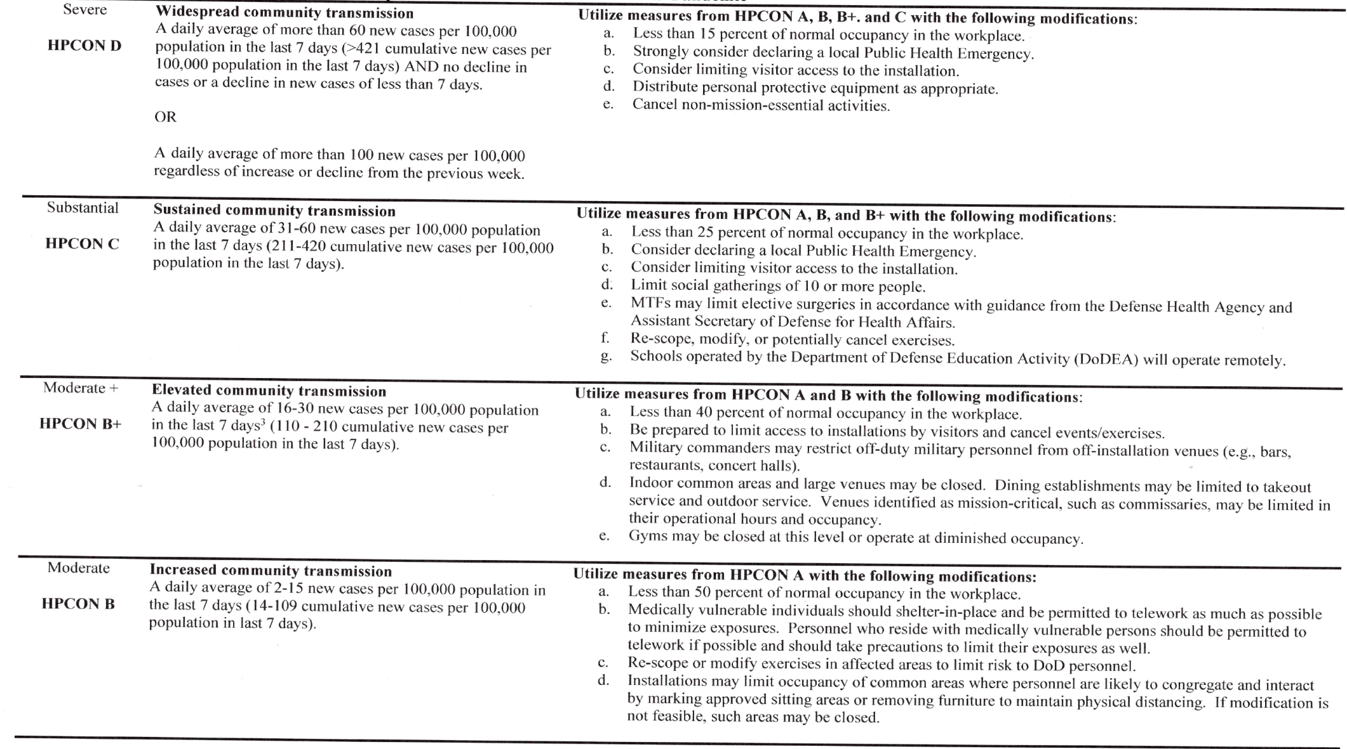
HPCON Levels for COVID-19 Pandemic
Notes:
1 Consider transmission rates, disease trajectory, and medical facility capabilities/capacities in changing HPCON levels. Case-rate thresholds should not be the sole determining factor for an installation's HPCON level but instead should serve as guidelines to be integrated into a comprehensive review process.
2 MILDEPs may delegate HPCON level determination to a level no lower than the military installation commander.
3 CDC high transmission is 2: I 00 new cases per l 00,000 population in the last 7 days (a daily average of> 14.3 new cases per I 00,000 population in the last 7 days).

Slide 3
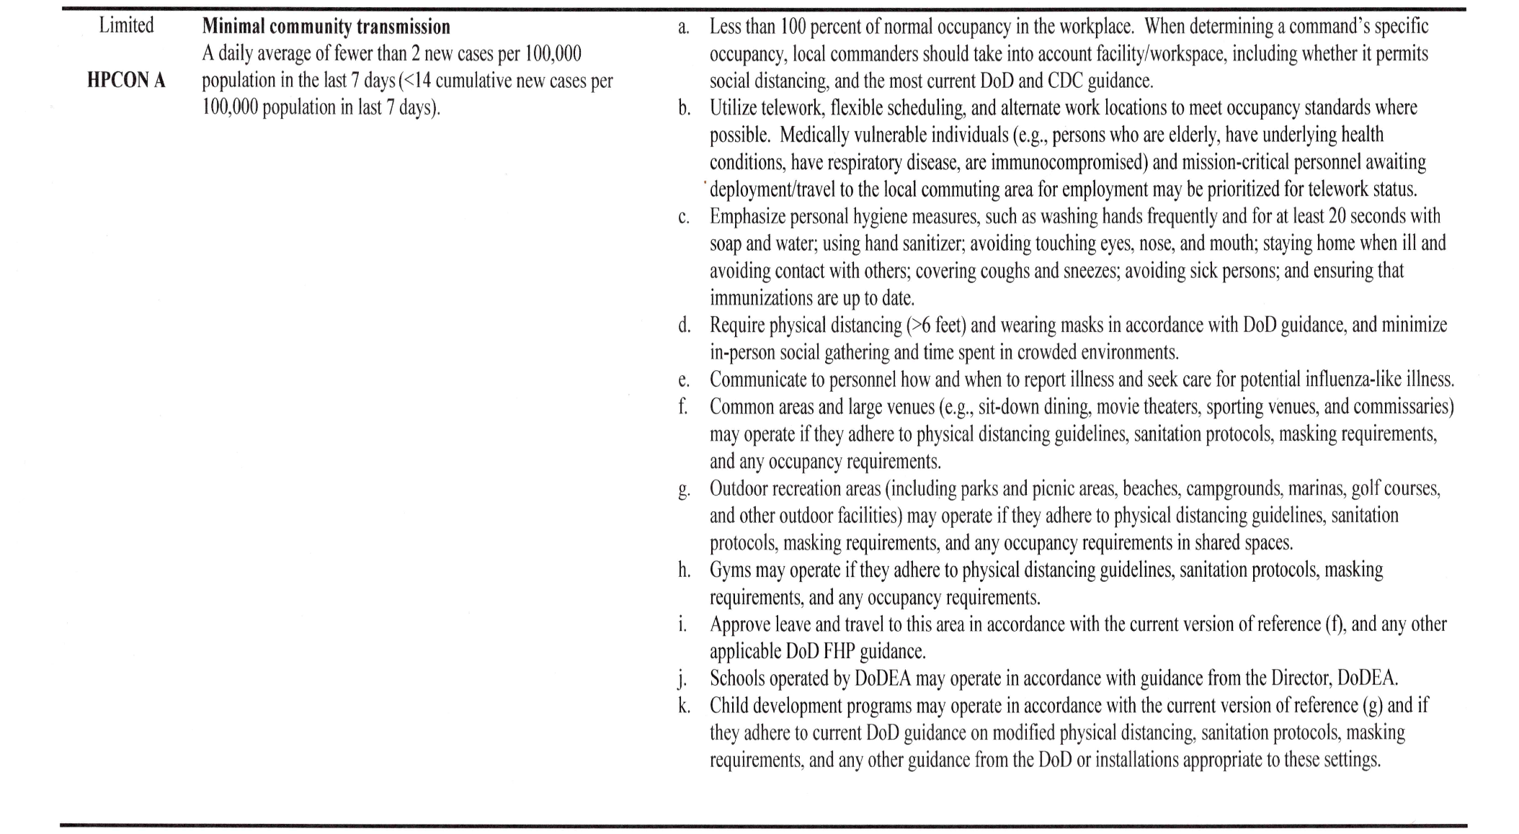
HPCON Levels for COVID-19 Pandemic

Slide 4
Summary of changes in guidance
HPCON B
Less than 50% in workplace
Maximize telework
  Medically vulnerable telework as much as possible
Military leave approved by commander
May limit occupancy of common areas
  Modify areas to accommodate (e.g., Limit seating and modify Riverside Dining Facility (RDF) traffic flow)
HPCON A
Less than 100% in workplace
Utilize telework where possible
  Medically vulnerable may be prioritized for telework status
Normal operations for local military leave approval
  Commanders/Directors must approve leave outside the local area
Normal operation for common areas for fully vaccinated
  Personnel who are fully COVID vaccinated may enter DoD facilities without a mask. Masked/unvaccinated personnel must still practice physical distancing in accordance w/DoD guidance (e.g., max seating except where mask worn, normal RDF traffic flow)
  Exceptions: All members, regardless of vaccine status, must wear a mask in MDG, satellite pharmacy, public conveyances, and transportation hubs per outside agency guidance (DHA, AMC, etc.)
May ask employees for vaccination status to verify appropriate mask wear
  Commanders may ask Military members if they are fully vaccinated
  Supervisors may ask civilians if they are vaccinated when they have reliable information, such as firsthand knowledge of voluntary employee statements, that the member may not be vaccinated.

Slide 5
Questions?
Do we know if other DoD bases are at HPCON A? Yes, 26 AF installations including VSFB.
List of things we are still not doing . . . e.g., Buffets at Tides Club
Should we resume South Gate launch viewing to the public without restrictions? No.

