Slide 1


Spaceport of the Future Infrastructure (SPotFi)
2026 Program

Slide 2
OVERVIEW
Introduction
Spaceport of the Future Overview
SPotFi Projects FY26
SPotFi Projects MILCON
Questions
2

Slide 3
Meet the Team
Contracting Officer - Heather Carino
Spaceport of the Future Development Director – Andrew Duce
Chief, Cape Support Element, 45 CES – Jacob Laird
Spaceport of the Future Representative – Isabel Gray
THANOS Contract Support
  Contract Specialists: David Rogers and Steven Darling
  Project Managers: David Cannon and Kevin Beasley
3

Slide 4
Program Scope & Intent
The U.S. Space Force’s Range of the Future 2028 Strategic Intent identified the requirement to increase launch posture over the next 10 years. Infrastructure must be improved to meet this new requirement.
Primary Goals:
  Range must be able to support launching EVERY day.
  Range must be able to support multiple launches per day.
  Range must eliminate all critical day restrictions.
  Establish infrastructure redundancy and resiliency.
  Reduce personnel impacts associated with launch and landing activities.
  Quick execution projects by completing environmental planning upfront.
  Previous Completed for SPotFi Execution:
  District Plans: Cape Canaveral Space Force Station & Patrick Space Force Base
  Infrastructure Roadmap (IR)
  Environmental Assessments (EA): Cape Canaveral Space Force Station & Patrick Space Force Base
  Program Integration Team (PIT): Stood up 20-person office to execute program
4

Slide 5
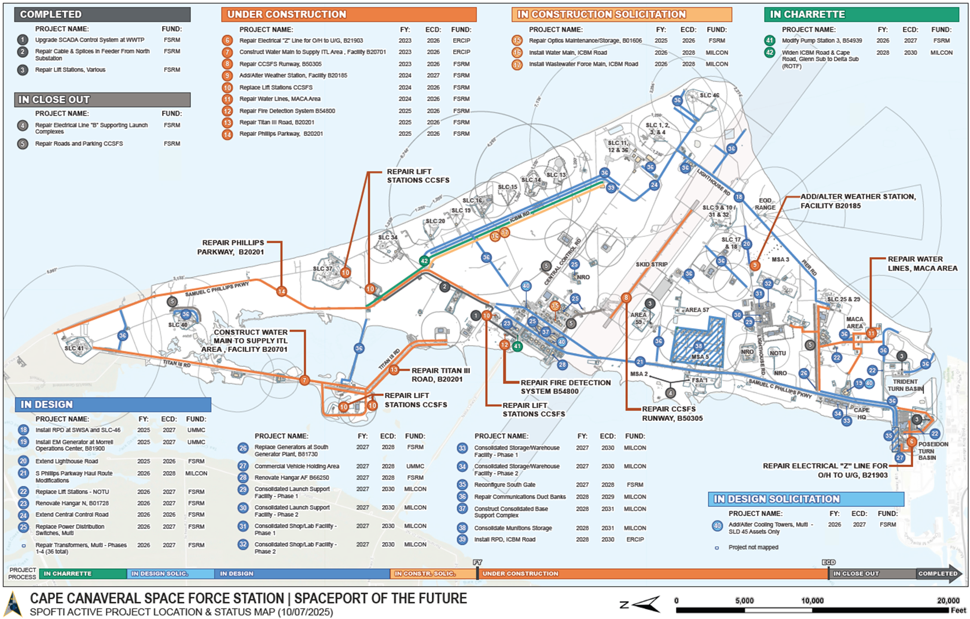
5

Slide 6
Projected Remaining FY26 Program
Facility Renovation – 3 Projects, $25-30M
Electrical Distribution – 8 Projects, $25-30M
Water/Wastewater – 2 Projects, $5-10M
HVAC – 1 Project, $5-10M
Paving – 2 Projects, $1-5M
Demo – 1 Project, $1-5M
Projected Total: 17 Projects, $70-80M
6

Slide 7
SPOTFI MILCON
Nearly $1B in MILCONs to be awarded over the next 36 Months!
  FY26: 3 Projects
  FY27: 7 Projects
  FY28: 6 Projects
  FY29: 4 Projects
Projected Total: 20 MILCONs projected for awarded through 2029
7

Slide 8






8

Slide 9
CCSFS dFSRM Construction
2026 Program

Slide 10
OVERVIEW
Introduction
CCSFS FY26 Projects Overview
Questions
10

Slide 11
Meet the Team
Contracting – 45 CONS
Program Manager - Chief, Cape Support Element, Jacob Laird
Project Managers – 45 CES CENM/CEZL/CEZR
11

Slide 12
Projected Remaining FY26 Program
Facility Renovation – 6 Projects, $1-5M
Electrical Distribution – 2 Projects, $1-5M
Water/Wastewater – 2 Projects, $1-5M
HVAC – 5 Projects, $5-10M
Paving – 2 Projects, $1-5M
Demo – 2 Projects, $1-5M
Projected Total: 19 Projects, $15-20M
12

Slide 13
Past Projects
Repair by Replacement HVAC Package Units
  Remove the existing HVAC system at the north side of facility and install a new package HVAC unit on the south side of the facility. Demo existing condenser, AHU and external lighting. Replace with same size units and tie ductwork into existing duct work.
Repair Parking Areas, Multiple
  Repair all cracks and potholes as necessary. Re-seal, then re-stripe parking areas to match existing. Remove and dispose of existing wheel stops. Repaint all bollards. There is a total of 155 parking spaces and 18 bollards. Mill and overlay secondary lot w/Asphalt, area is 3,300 SY. There is a total of 74 parking spaces.
13

Slide 14
CCSFS, PSFB, and AAAF
A&E Services

Slide 15
OVERVIEW
Introduction
Targeted Capabilities
Questions
15

Slide 16
Meet the Team
Contracting – 45 CONS, Patricia Bates and Gina Russell
Program Manager - Chief, Cape Support Element, Jacob Laird
COR – 45 CES CENM, Nelly Walker
Project Managers – 45 CES
16

Slide 17
Targeted Capabilities (Design)
Program Management: End-to-end execution of 35-65 annual design task orders with robust cost, schedule, and quality controls.
Full-Lifecycle Engineering: Multidisciplinary design (Civil, Structural, MEP, Architectural, Fire Protection) from concept through final design.
Specialized Facilities: Expertise in unique military and aerospace requirements, including launch complexes, SCIFs, and advanced utility systems.
Environmental Compliance: Comprehensive support for environmental impact analysis, permitting, and strict regulatory adherence.
Urgent Design/Build: Rapid-response construction execution and administration for mission-critical, time-sensitive projects.
17

Slide 18
Targeted Capabilities (Services)
Construction Management & Inspection: Comprehensive on-site surveillance, quality assurance, and schedule/submittal management for a large portfolio of complex construction projects (valued over $55M).
Program & Project Management: Cradle-to-grave execution of SRM, MILCON, and energy projects, including DD Form 1391 development and systems administration (NexGenIT/BUILDER).
Specialized On-Site Support: Provision of restricted area escorting for secure sites, facility space utilization management, and rapid-response disaster damage assessments.
Energy Program Leadership: Full-lifecycle management of a $100M+ energy and water conservation portfolio, including Level 1 audits and ECO development.
18

Slide 19
Past Projects
Replace Water Lines South Phillips Parkway
  Repair approximately 7,500 linear feet of potable water lines in the South Phillips Pkwy area. Convert larger mains to fire water only. Add water meters as needed. Add new water line service as needed.
Repair Optics Facility Hangar G
  Renovate and upgrade Hangar G. Building is an approximately 3,252 square meter facility with approximately 2,137 square meter hangar bay, and 2-story office space with shops and associated administrative support areas. Facility repairs are to include remediation of lead paint and asbestos, replacement of hangar doors, replacement of windows and main doors as needed, renovation of the restrooms, repair/replacement of ceilings, replacement/upgrade of the HVAC system, replacement/upgrade of the lighting system, replacement and upgrade of the fire protection system, and installation of a new building fire alarm/mass notification system.
19

